Slide 1
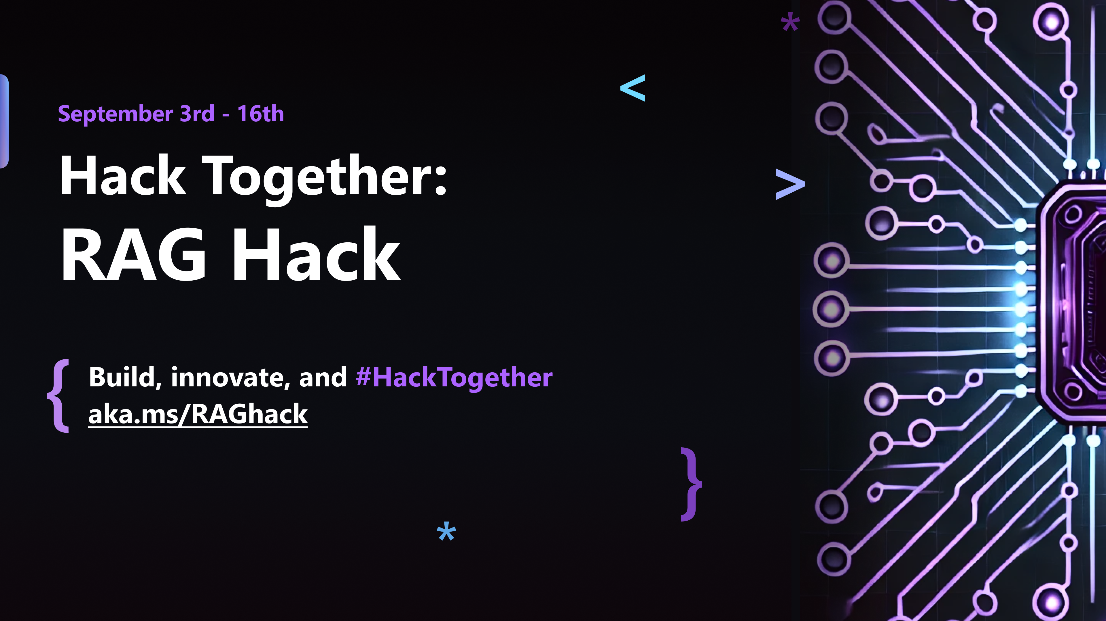

Slide 2
RAG applications with LangChain and Azure Cosmos DB for MongoDB
Khelan Modi Product Manager
John Aziz MVP
Notes:
James

Slide 3
Agenda
vCore-based Azure Cosmos DB for MongoDB
Azure OpenAI & LangChain
Demo
Links
​Demo code: aka.ms/vcorelangchain
Notes:
James
VCore: No Code to build an AI application
Copilot: Turn natural language to NoSQL queries
Flex: Upgrade your old SQL application to integrate AI capabilities with just a few lines
I've got a surprise for you during this presentation, and here's the twist - it's not hiding at the very end. So, if you were planning on sneaking out for a coffee break and then coming back in for the big reveal, well, I hate to break it to you, but that won't work!

Slide 4
What is vCore-based Azure Cosmos DB for MongoDB
Fully managed MongoDB compatible database
Multi-region Global Deployment
High capacity vertical and horizontal scaling
Native Azure integrations
Vector Search and Indexing built-in
Low TCO
Azure Cosmos DB for MongoDB Free tier: aka.ms/tryvcore
Notes:
Azure Cosmos DB for MongoDB vCore offers a fully managed MongoDB compatible database service designed specifically for developers aiming to create intelligent applications. The vCore model, which is a VM-based architecture, provides flexibility to scale your database both vertically and horizontally, to accommodate the requirements of your workloads.
What's great about vCore is its transparent pricing structure, charging a flat fee based on the actual usage of compute resources and storage. By integrating the well-established MongoDB framework with the Azure ecosystem, vCore ensures a low total cost of ownership, packed with optimal performance and scalability. This solution excels when handling workloads that involve long-running queries and complex aggregation pipelines.

Slide 5
GenAI use cases with Azure Cosmos DB
What
Why
When
a
Drastically reduces latency
Saves on Token consumption
Reduces costs and latency for LLM
Semantic Caching
Slow moving / static content
FAQs, Policies…
Conversational context
UX improvements
LLM optimizations
Auditing
Chat History
A MUST for Chat sessions
Improving cost & performance
Retrieval Augmented Generation (RAG)
Personalize LLM on your data
Cheaper than fine tuning
Faster iteration on new data
Any workload for GenAI apps
Vector + Operational Database
No ETL
Consistent data
Reduce complexity & costs
Data & vectors together
Cosmos DB scale & performance
Notes:
With these capabilities, the possibilities for Gen-AI scenarios using Azure Cosmos DB expand greatly.
Combining an Operational + Vector database, eliminates the need to ETL data into a single purpose vector database, reducing complexity and cost.
Building RAG Pattern applications gets easier and enables Gen-AI applications in mission critical and real-time workloads.
Cosmos DB has always been a favorite for building Chat applications. Users can now take chat history to improve user experience and optimize their LLMs.
And finally, it enables new innovations such as semantic caching, which drastically reduces costs and improves performance even more.
However, we’re not done yet. Azure Cosmos DB is known for its performance and scale, and we’re are going to take things even further.

Slide 6
Azure OpenAI
Text
🔃
1 2 3 4 5 6 7 8 9 0
️
Hey
Hi
Chat Deployment
Embedding Deployment
Notes:
Chat Deployment refers to using AI models, like GPT, for conversation-driven applications. These models are designed to understand and generate human-like responses in real-time interactions.
In the slide, the two chat bubbles represent an interaction between the user and an AI-powered system, where a user types "Hi" and the model responds in a conversational manner.
What is Embedding Deployment?
Embedding Deployment involves using AI models to generate vector-based representations (embeddings) of text, numbers, or other data. These embeddings can capture the semantic meaning of data, allowing for powerful search, comparison, and recommendation capabilities.
The image of text and numbers on the slide symbolizes embedding generation – turning raw data into vectors that the AI can use for various tasks.
Use Cases for Embedding Deployment:
Search Optimization: For example, embedding-based search can provide more relevant search results by understanding the context and meaning behind search queries and documents, rather than relying on keyword matching.
Recommendation Systems: Similarity between vectors can help make personalized recommendations based on user preferences and past behavior.
Semantic Search: Businesses can deploy this for document search, where the AI understands not just the keywords but the intent behind the search.
Clustering & Categorization: Grouping similar data points or documents together based on their vector similarity for use cases like document classification or product categorization.
Benefits of Embedding Deployment:
Enhanced Search Capabilities: Goes beyond keyword-based searches, delivering results based on meaning, which is crucial for industries like legal, healthcare, and ecommerce.
Data-driven Insights: Embeddings allow businesses to uncover hidden patterns or relationships in data that traditional methods might miss.
Scalability and Speed: Vector-based searches are highly scalable, enabling fast and efficient similarity searches even across large datasets.
A chatbot could be enhanced with embedding search capabilities to provide smarter answers. For example, when a customer asks a question, the bot not only responds but also retrieves the most relevant documents or similar past interactions using embeddings.
Embeddings could help a chatbot recommend products, services, or information based on contextual understanding of the user’s past interactions.

Slide 7
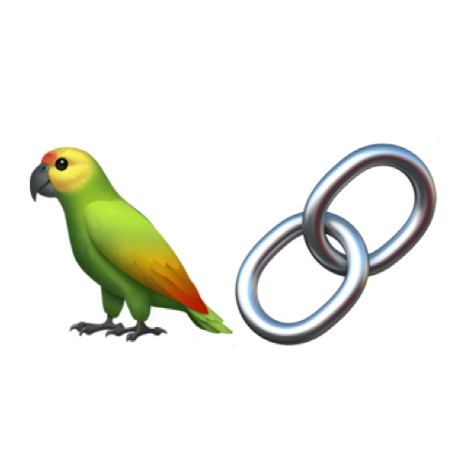
LangChain
A framework for developing applications powered by language models (LLMs), combining LangChain with Azure Cosmos DB for MongoDB for data storage and retrieval, while also providing real-time insights
Key Features:
Supports dynamic data retrieval via APIs or databases.
Framework for orchestrating LLM calls with business logic.
Seamless integration with external data sources for fine-tuning LLM results.

Slide 8
vCore-based Azure Cosmos DB for MongoDB
AI Ready
New Additions
Coming soon
Native filtered-Vector Search, including HNSW and IVF
Plugins: LangChain, Semantic Kernel, and LlamaIndex
Integration with Azure OpenAI Studio, Azure AI Studio
Free tier w/ 32GB storage
Private link - GA
Geo-DR Up to 32TB storage per shard (preview)
MongoDB v7 Support
Autoscale
Embedding generation
DiskANN
Learn more: aka.ms/tryvcore
Notes:
Khelan:
We are proud announce our newest member of the cosmos DB family, which has a different form factor, which is cluster form that allows to scale up and out.
vCore- it is fully manager MongoDB compatible databse service for building modern applicaoitn with a familiar architecture. With Cosmos DB for MongoDB vCore, developers can enjoy the benefits of native azure integrations, low total cost of ownership, and the famialr vCore architecture when migrating existing applications or building new ones.
Free tier w/ 32 GB storage (which is 64x times other comparable tiers)
Burstable SKUs,
We have upgrade our tiers to configure multiple tiers and storage SKUs
We have support for Private Link,
We provide easy migration from MongoDB to MongoDB vCore
Additionally, vCore is AI ready, it includes native vector search, along with ivf and HNSW. It is built into the engine, it is not built on a separate node, you dont have to pay extra or move your data. Therefore, your data, embeddings, vectors, and vector indexing is built in to the database, therefore you can do you RAG pattern efficiently.
We provide plugins for LangChain, Semantic kernel, and LLamaIndex. Additionally, easy integration with Azure openAI studio to build applications without writing a single line of code, which we will talk about in a minute.

Slide 9

Retrieval Augmented Generation
Empower LLMs with Operational Data context
Retrieval augmented generation
Grounding the searches with vector data seamlessly
Support large Knowledge bases for ingestion and retrieval
Semantic caching
Prompt history
1
2
Chunked docs
Embedding model
embeddings
Documents
5
6
9
User
query
Prompt
history
&cache
Vector
search
3
4
“Create a quiz with 10 questions based on xyz data”
User query
Embedding model
Vectorized prompt
7
Prompt + context
Large language model (LLM)
Chat
9
Generated output
Response
8

Slide 10
Demo

Slide 11
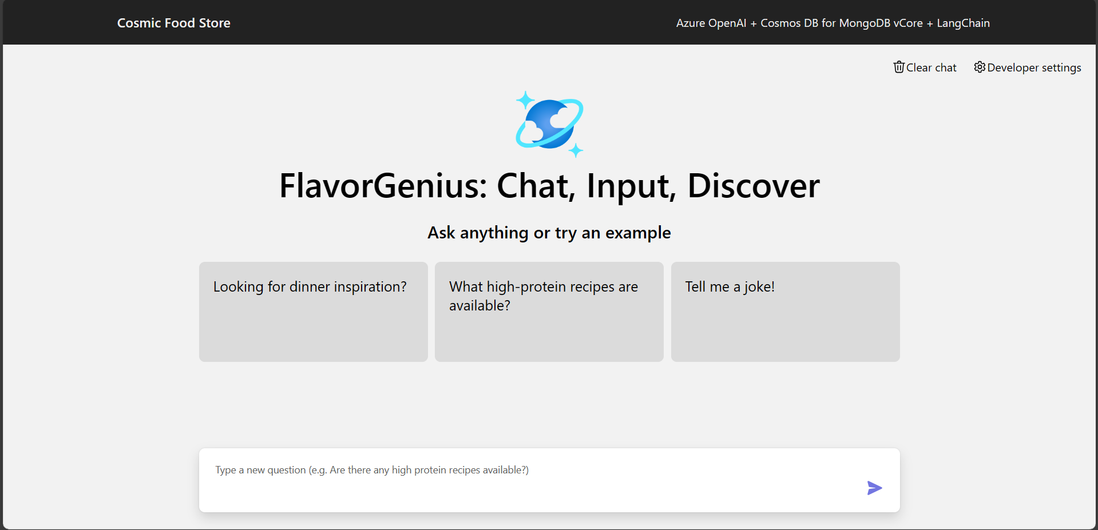
Homepage screenshot

Slide 12
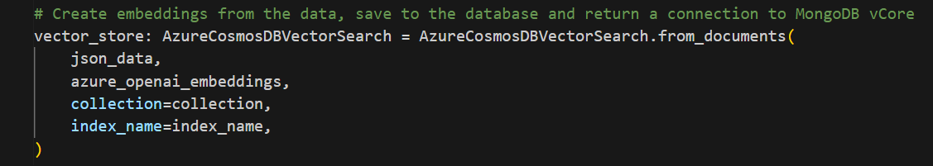
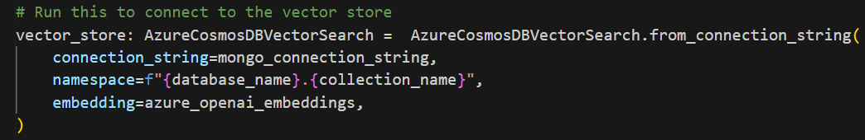
Setting up a vCore cluster with Langchain

Slide 13
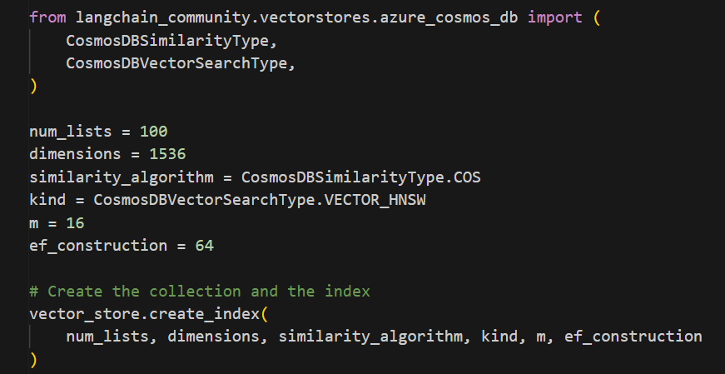
Creating a HNSW vector index

Slide 14
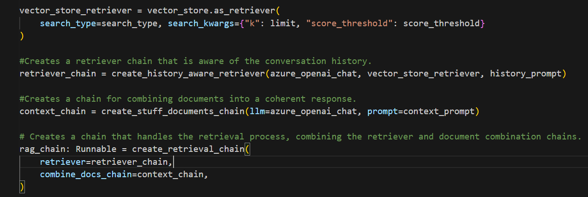
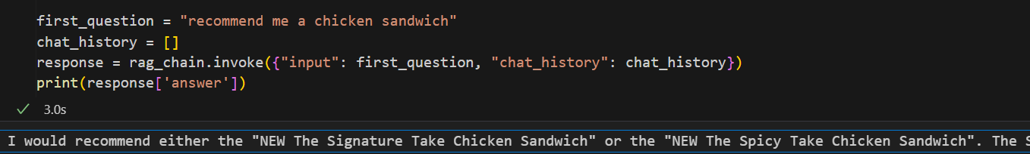
Homepage screenshot

Slide 15
Learn More
Azure Cosmos DB for MongoDB vCore Free tier: Aka.ms/tryvcore
Demo code: Aka.ms/vcorelangchain
Additional samples, docs and more: Aka.ms/CosmosAISamples

